Slide 1

Tendencies and Trends in NLP Word Embedding, Representation Learning, Document Classification, …
Navid Rekabsaz
Idiap Research Institute
navid.rekabsaz@idiap.ch
@navidrekabsaz

Slide 2
Natural Language Understanding
A great challenge in AI
How can we think, understand, and communicate with each other through sequences of symbols?
What is the structure of human thoughts?
How can we calculate a structured thought from an observed sequence?
How can calculate a sequence to convey a structured thought?

Slide 3

Natural Language Understanding
We do not know how to directly conceptualize intelligence.
Instead, we usually rely on learning from experience and data
Modeling can lead to new insights on the origin
Model
generate
Data

Slide 4
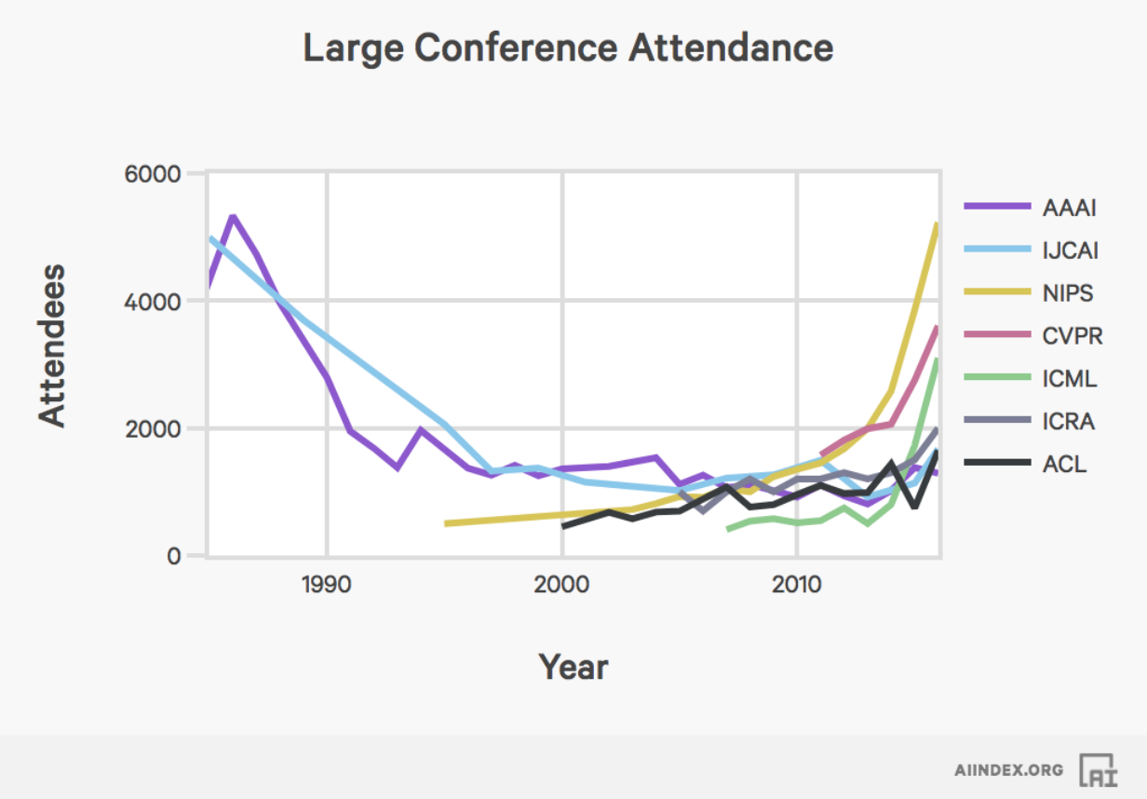
Research on AI and NLP

Slide 5
Job Market

Slide 6
Agenda
Crash course (1)
Vector representation
Neural Networks
Word Representation Learning
Neural word representation
word2vec
---Break---
Crash course (2)
Recurrent Neural Networks
Attention Mechanism
Document Classification
Applications and challenges

Slide 7
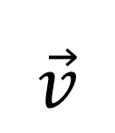
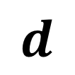
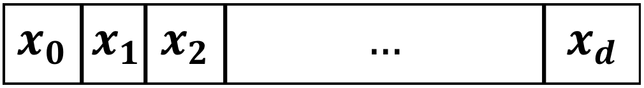
Vector Representation
Computation starts with representation of entities
Common entities in NLP: word, sentence, document, etc.
An entity is represented with a vector of d dimensions
The dimensions usually reflects concepts, related to an entity
$$d$$
$$\vec{v}$$
$$x_{0}$$ | $$x_{1}$$ | $$x_{2}$$ | $$…$$ | $$x_{d}$$

Slide 8
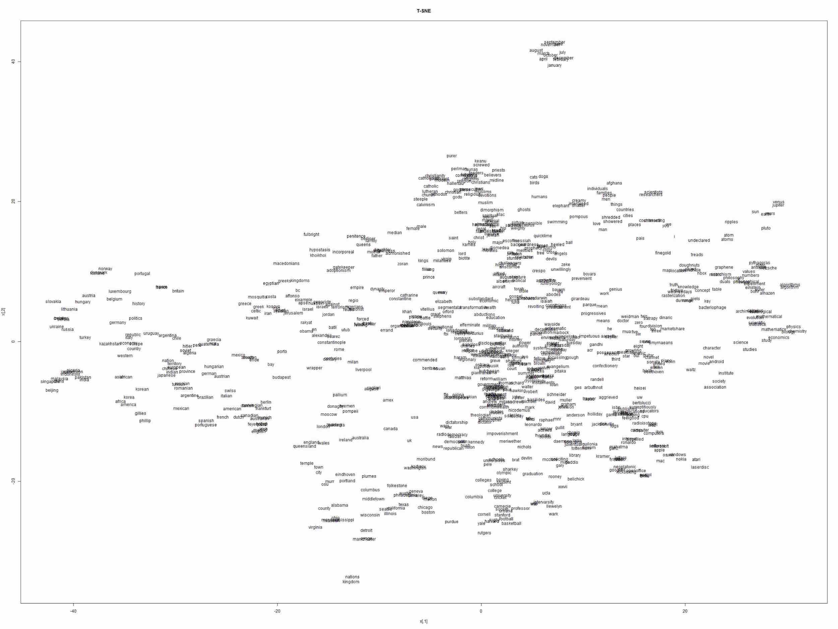
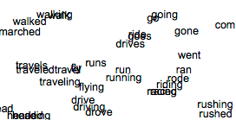
Vector representations of words projected in two-dimensional space

Slide 9
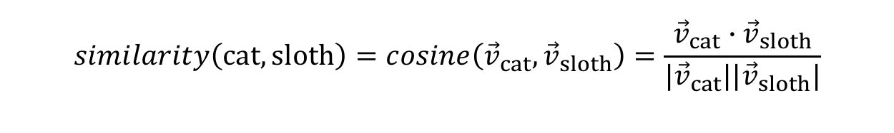
Vector Representation
Vector representations (in this course) are usually:
in dimensions around d ~ [10-1000]
dense
referred to as embeddings: e.g. word embedding
The similarity between the entities can be computed by any distance/similarity measure:
Usually by dot product or cosine (normalized dot product) between the vectors
$$similarity\left(cat,sloth\right)=cosine\left({\vec{v}}_{cat},{\vec{v}}_{sloth}\right)=\frac{{\vec{v}}_{cat}∙{\vec{v}}_{sloth}}{{|\vec{v}}_{cat}||{\vec{v}}_{sloth}|}$$

Slide 10
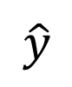
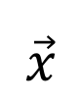
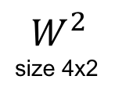
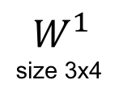
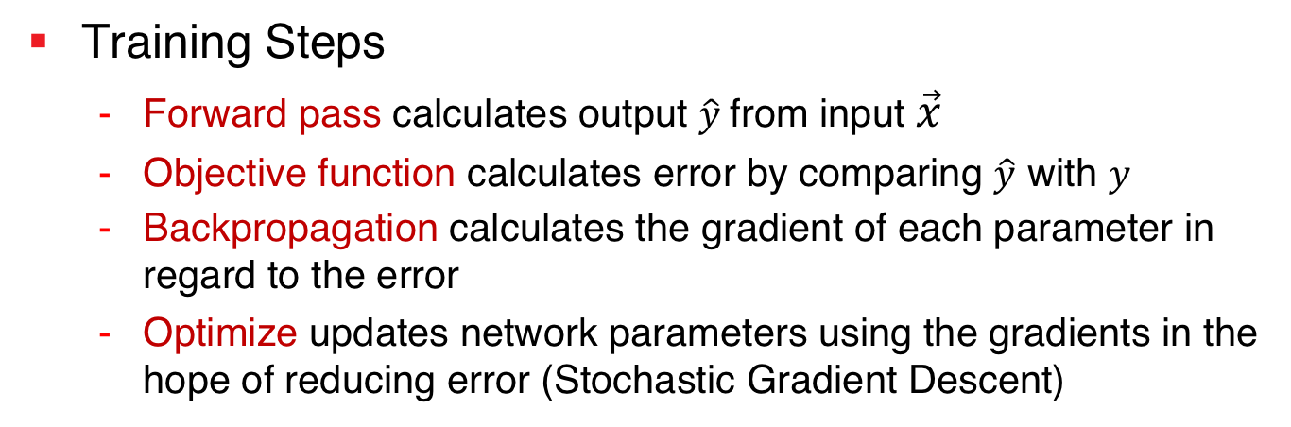
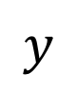
Neural Networks
input vector
prediction
labels
$$\vec{x}$$
$$\hat{y}$$
$$y$$
objective function
$$W^{1}$$
size 3x4
$$W^{2}$$
size 4x2
parameter matrices
Training Steps
Forward pass calculates output $\hat{y}$from input $\vec{x}$
Objective function calculates error by comparing $\hat{y}$ with $y$
Backpropagation calculates the gradient of each parameter in regard to the error
Optimize updates network parameters using the gradients in the hope of reducing error (Stochastic Gradient Descent)

Slide 11
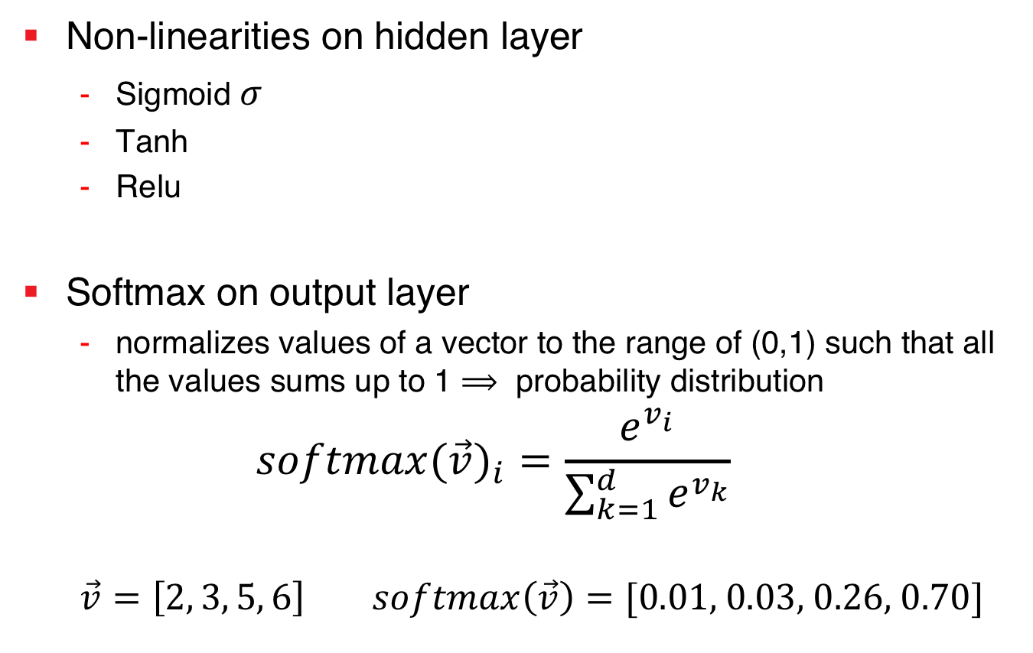
Neural Networks
Sigmoid function
Non-linearities on hidden layer
Sigmoid $σ$
Tanh
Relu
Softmax on output layer
normalizes values of a vector to the range of (0,1) such that all the values sums up to 1 $⟹$ probability distribution
$${softmax(\vec{v})}_{i}=\frac{e^{v_{i}}}{\sum_{k=1}^{d}{e^{v_{k}}}}$$
$\vec{v}=\left[2, 3, 5, 6\right] softmax\left(\vec{v}\right)=[\text{0.01}\text{, }\text{0.03}\text{, }\text{0.2}\text{6, }\text{0.}\text{70}]$

Slide 12



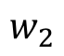
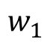
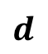
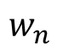
Word Representation Learning
$$d$$
$$w_{1}$$
$$w_{2}$$
Word Embedding Black-box
$$w_{n}$$

Slide 13
Intuition for Computational Semantics
“You shall know a word by the company it keeps!”
J. R. Firth, A synopsis of linguistic theory 1930–1955 (1957)

Slide 14
alcohol
drink
drunk
on the table
Tesgüino
make
out of corn
fermented
bottle of
Mexico
Nida[1975]

Slide 15
Dutch
drunk
pale
Heineken
brew
red star
bar
drink
green bottle
alcohol

Slide 16
Tesgüino ←→ Heineken
Algorithmic intuition:
Two words are related when
they have similar context words

Slide 17
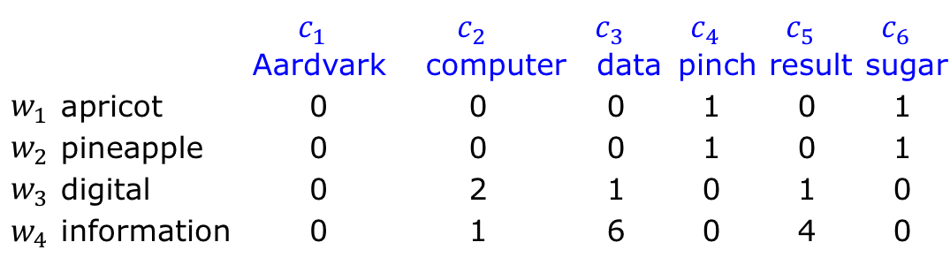
Word-Context Matrix
Number of times a word c appears in the context of the word w in a corpus
 |  | $$c_{1}$$ | $$c_{2}$$ | $$c_{3}$$ | $$c_{4}$$ | $$c_{5}$$ | $$c_{6}$$
 |  | Aardvark | computer | data | pinch | result | sugar
$$w_{1}$$ | apricot | 0 | 0 | 0 | 1 | 0 | 1
$$w_{2}$$ | pineapple | 0 | 0 | 0 | 1 | 0 | 1
$$w_{3}$$ | digital | 0 | 2 | 1 | 0 | 1 | 0
$$w_{4}$$ | information | 0 | 1 | 6 | 0 | 4 | 0
Our first word vector representation!!
[1]

Slide 18
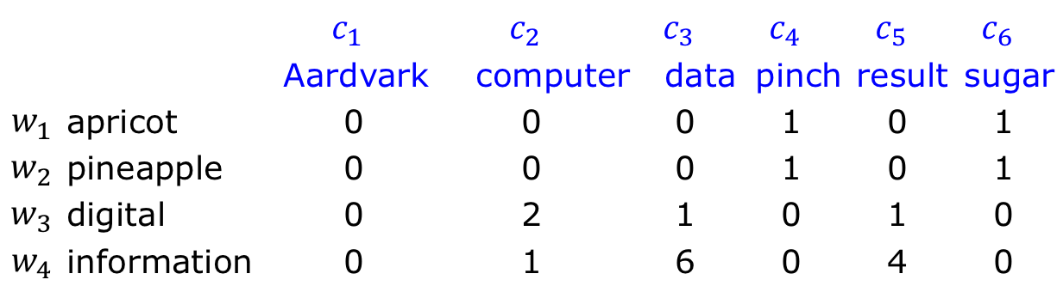
Words Semantic Relations
 |  | $$c_{1}$$ | $$c_{2}$$ | $$c_{3}$$ | $$c_{4}$$ | $$c_{5}$$ | $$c_{6}$$
 |  | Aardvark | computer | data | pinch | result | sugar
$$w_{1}$$ | apricot | 0 | 0 | 0 | 1 | 0 | 1
$$w_{2}$$ | pineapple | 0 | 0 | 0 | 1 | 0 | 1
$$w_{3}$$ | digital | 0 | 2 | 1 | 0 | 1 | 0
$$w_{4}$$ | information | 0 | 1 | 6 | 0 | 4 | 0
Co-occurrence relation
Words that appear near each other in the language
Like (drink and beer) or (drink and wine)
Measured by counting the co-occurrences
Similarity relation
Words that appear in similar contexts
Like (beer and wine) or (knowledge and wisdom)
Measured by similarity metrics between the vectors
$$similarty\left(digital,information\right)=cosine\left({\vec{v}}_{digital},{\vec{v}}_{information}\right)$$

Slide 19
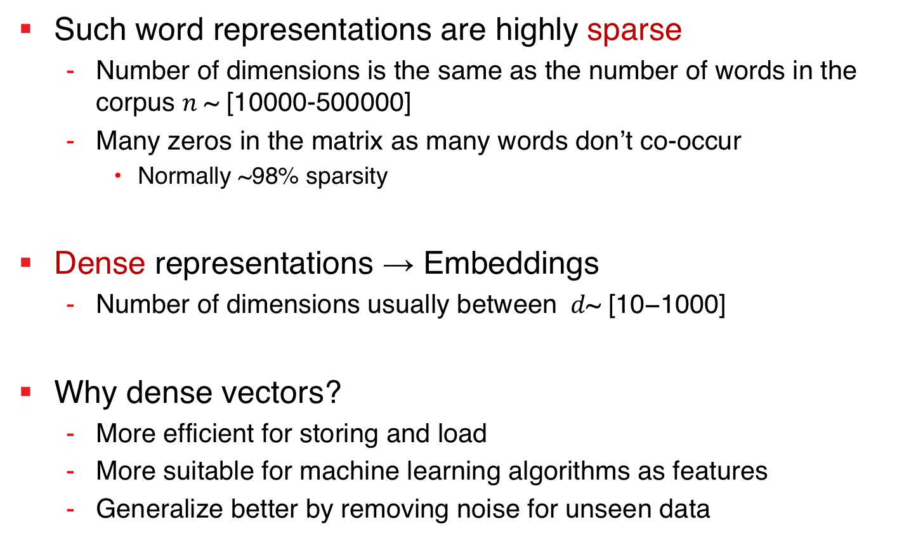
Sparse vs. Dense Vectors
Such word representations are highly sparse
Number of dimensions is the same as the number of words in the corpus $n \text{\sim } \text{[10000-500000]}$
Many zeros in the matrix as many words don’t co-occur
Normally ~98% sparsity
Dense representations → Embeddings
Number of dimensions usually between $d\text{\sim } \text{[10−}\text{1}\text{000]}$
Why dense vectors?
More efficient for storing and load
More suitable for machine learning algorithms as features
Generalize better by removing noise for unseen data

Slide 20
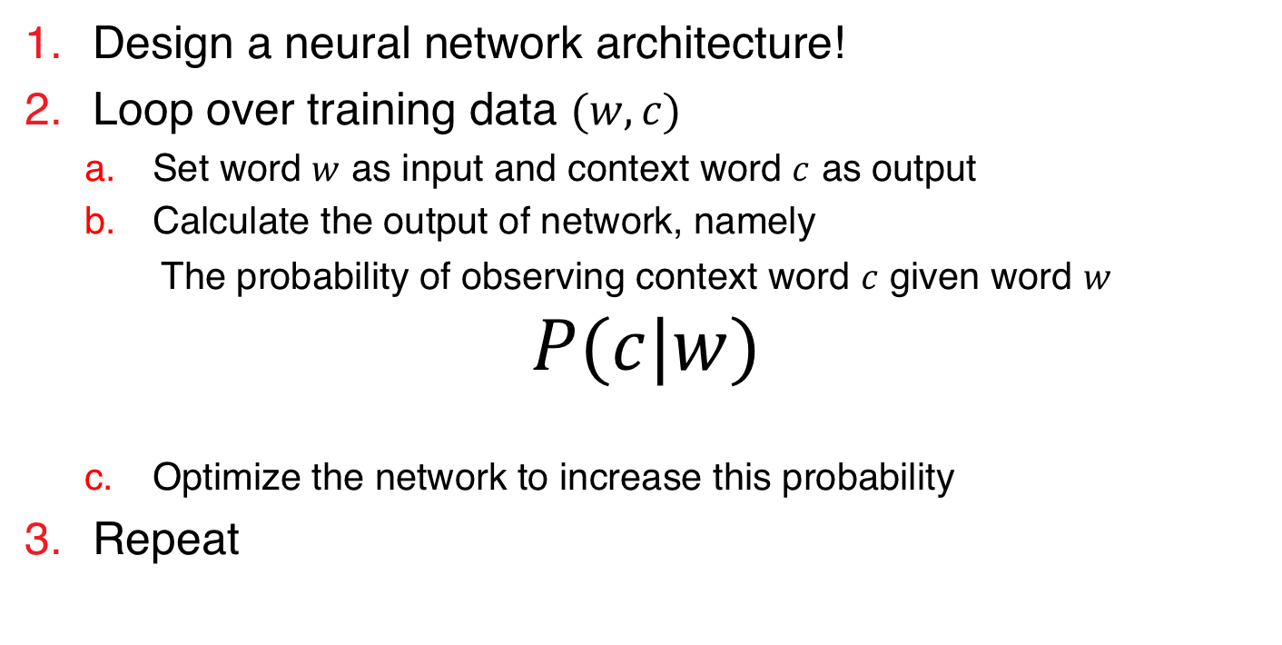
Word Embedding with Neural Networks
Recipe for creating (dense) word embedding with neural networks
Design a neural network architecture!
Loop over training data $(w,c)$
Set word $w$ as input and context word $c$ as output
Calculate the output of network, namely
The probability of observing context word $c$ given word $w$
$$P(c|w)$$
Optimize the network to increase this probability
Repeat
Details come next!

Slide 21

Prepare Training Samples
Window size of 2
http://mccormickml.com/2016/04/19/word2vec-tutorial-the-skip-gram-model/

Slide 22
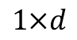
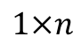
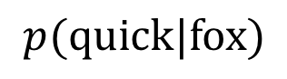
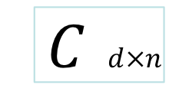
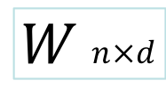
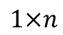
Neural Word Embedding Architecture
Train sample: (fox, quick)
Input Layer
(One-hot encoder)
Output Layer
(Softmax)
Forward pass
$$p(quick|fox)$$
Backpropagation
$$W n×d$$
$C$ $d×n$
$$1×d$$
$$1×n$$
Linear activation
$$1×n$$
Words matrix
Context Words matrix
https://web.stanford.edu/~jurafsky/slp3/

Slide 23
Heineken
Tesgüino
Word vector

Slide 24
Heineken
Tesgüino
Word vector

Slide 25
Heineken
Tesgüino
Word vector
Context vector

Slide 26
drink
Heineken
Tesgüino
Word vector
Context vector

Slide 27
drink
Heineken
Tesgüino
Word vector
Context vector

Slide 28
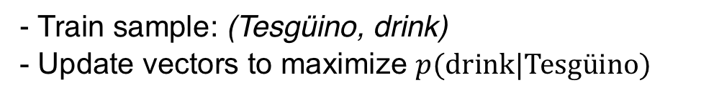
drink
Heineken
Tesgüino
- Train sample: (Tesgüino, drink)
- Update vectors to maximize $p(drink|Tesgüino)$
Word vector
Context vector

Slide 29
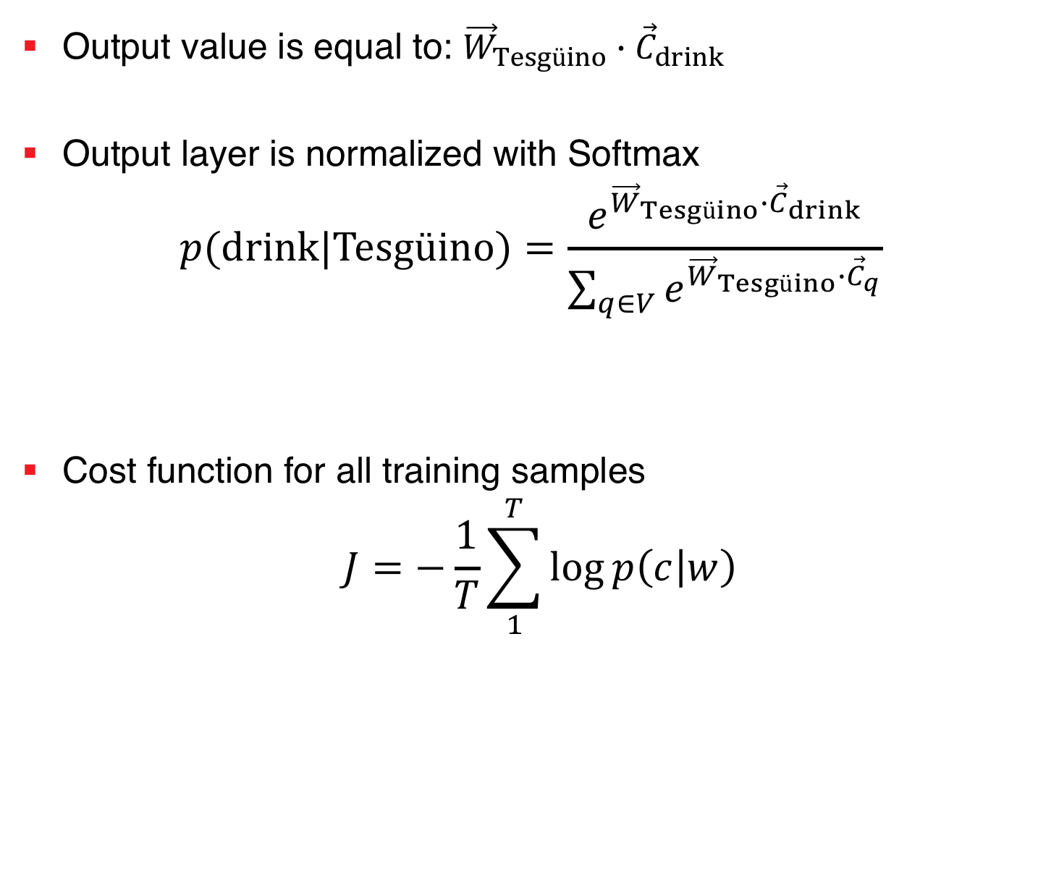
Neural Word Embedding - Summary
Output value is equal to: ${\vec{W}}_{Tesgüino}∙{\vec{C}}_{drink}$
Output layer is normalized with Softmax
$$p(drink|Tesgüino)=\frac{e^{{\vec{W}}_{Tesgüino}∙{\vec{C}}_{drink}}}{\sum_{q∈V}{e^{{\vec{W}}_{Tesgüino}∙{\vec{C}}_{q}}}}$$
Cost function for all training samples
$$J=−\frac{1}{T}\sum_{1}^{T}{\log{p\left(c | w\right)}}$$
Normalization is too expensive!

Slide 30
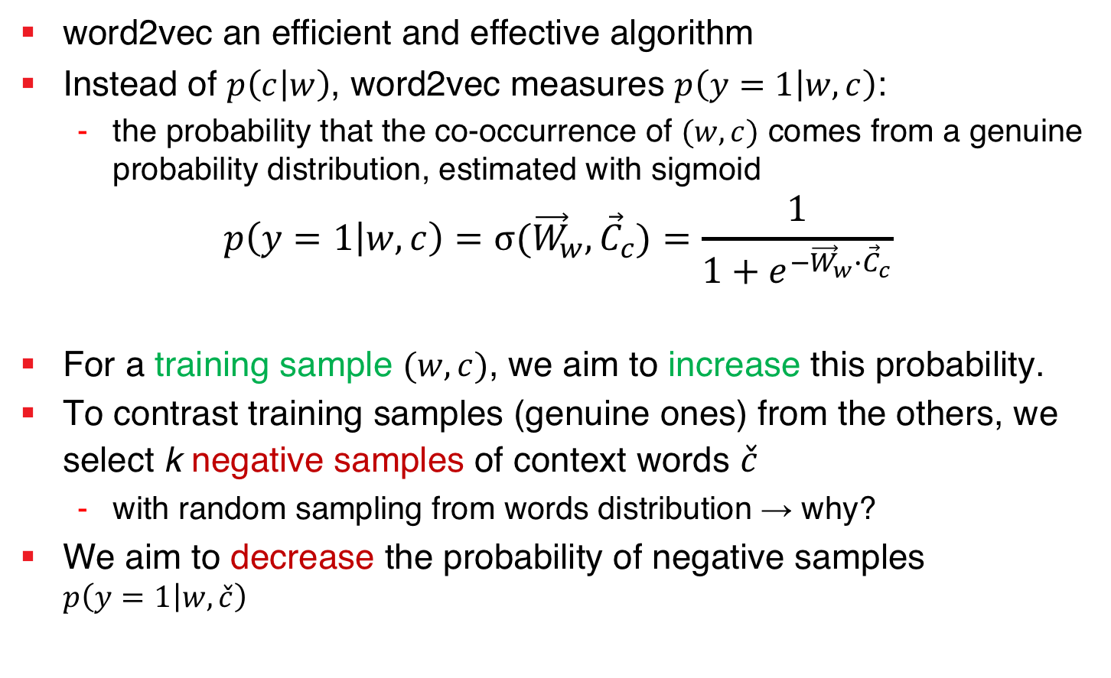
word2vec (SkipGram) with Negative Sampling
word2vec an efficient and effective algorithm
Instead of $p\left(c | w\right)$, word2vec measures $p\left(y=1 | w,c\right)$:
the probability that the co-occurrence of $(w,c)$ comes from a genuine probability distribution, estimated with sigmoid
$$p\left(y=1 | w,c\right)=σ{({\vec{W}}_{w},{\vec{C}}_{c})}=\frac{1}{1+e^{−{\vec{W}}_{w}∙{\vec{C}}_{c}}}$$
For a training sample $(w,c)$, we aim to increase this probability.
To contrast training samples (genuine ones) from the others, we select k negative samples of context words $\check{c}$
with random sampling from words distribution → why?
We aim to decrease the probability of negative samples $p\left(y=1 | w,\check{c}\right)$

Slide 31
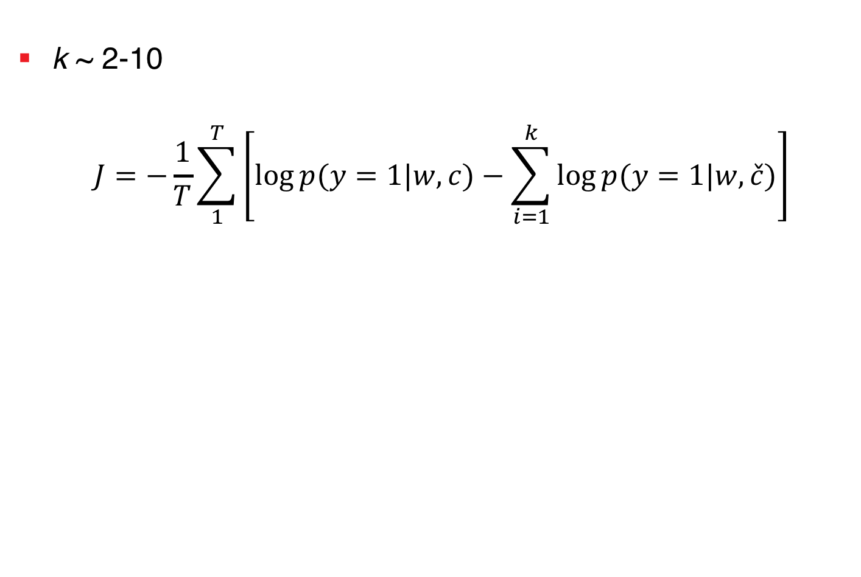
word2vec with Negative Sampling – Objective Function
k ~ 2-10
$$J=−\frac{1}{T}\sum_{1}^{T}{\left[\log{p(y=1|w,c)}−\sum_{i=1}^{k}{\log{p(y=1|w,\check{c})}}\right]}$$
Training Samples
Negative Samples

Slide 32
drink
Tesgüino
Train sample: (Tesgüino, drink)
Word vector
Context vector

Slide 33
drink
Tesgüino
Train sample: (Tesgüino, drink)
Sample k negative context words
Word vector
Context vector

Slide 34
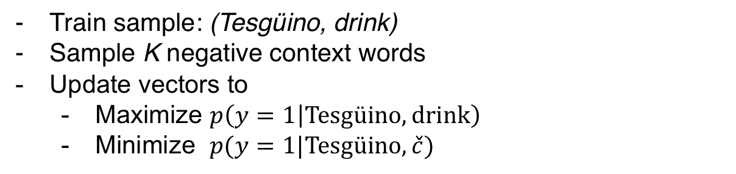
drink
Tesgüino
Train sample: (Tesgüino, drink)
Sample K negative context words
Update vectors to
Maximize $p\left(y=1 | Tesgüino,drink\right)$
Minimize $p(y=1|Tesgüino,\check{c})$
Word vector
Context vector

Slide 35
Word Embedding - Evaluation
Intrinsic
Given a list of pairs and their relatedness, judged by human, what is the correlation of similarity values, when generated by a word embedding model.
Extrinsic
The effect of using a word embedding model in another task such as sentiment analysis, document classification, document retrieval, etc..
“In general word2vec provides a strong and consistent baseline and a good starting point for task-specific representation learning”

Slide 36
Agenda
Crash course (1)
Vector representation
Neural Networks
Word Representation Learning
Neural word representation
word2vec
---Break---
Crash course (2)
Recurrent Neural Networks
Attention Mechanism
Document Classification
Applications and challenges

Slide 37
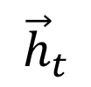
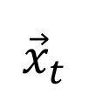
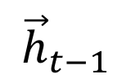
Recurrent Neural Networks
Encodes sequences of entities
Sequence of words
Time series
The output in every step uses the output of the previous step
It carries a memory of past entities
$${\vec{h}}_{t}$$
$${\vec{h}}_{t−1}$$
RNN
$${\vec{x}}_{t}$$

Slide 38
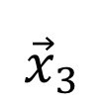
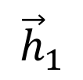
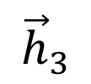
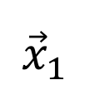
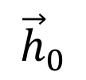
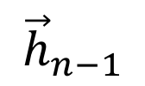
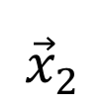
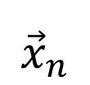
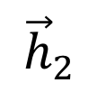
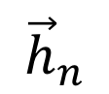
Recurrent Neural Networks
sentence embedding
$${\vec{h}}_{0}$$
$${\vec{h}}_{1}$$
$${\vec{h}}_{2}$$
$${\vec{h}}_{3}$$
$${\vec{h}}_{n}$$
$${\vec{h}}_{n−1}$$
RNN
RNN
RNN
…
RNN
$${\vec{x}}_{1}$$
$${\vec{x}}_{2}$$
$${\vec{x}}_{3}$$
$${\vec{x}}_{n}$$
The quick brown fox jumps over the lazy dog

Slide 39
Recurrent Neural Networks
Various types
Standard (Elman) RNN
Long Short Term Memory (LSTM)
Gated Recurrent Unit (GRU)
Bi-directional RNN
Two RNNs: the first reads from beginning to end, the second from end to beginning
Output at each time step is the sum of the hidden states of both RNNs
Bi-RNN
Bi-RNN
Bi-RNN

Slide 40
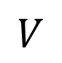
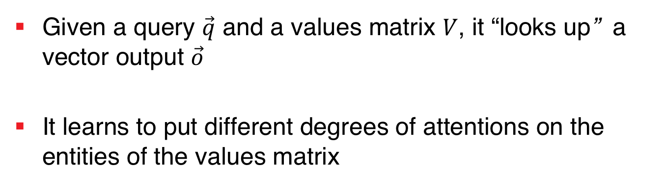
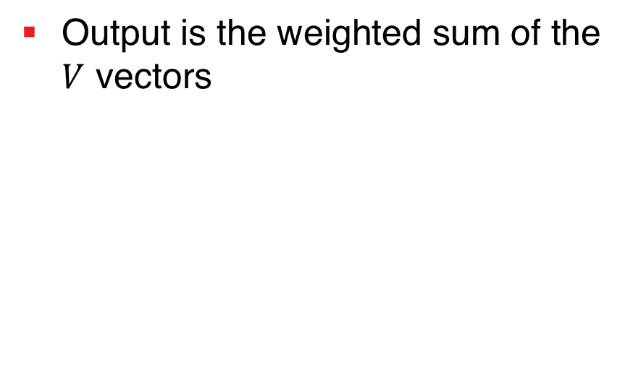
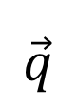

Attention Mechanism (simplified)
Given a query $\vec{q}$ and a values matrix $V$, it “looks up” a vector output $\vec{o}$
It learns to put different degrees of attentions on the entities of the values matrix
$$\vec{o}$$
Output is the weighted sum of the $V$ vectors
$$\vec{q}$$
Attention
$$V$$

Slide 41











Attention Mechanism
$$\vec{o}$$
$$α_{i}=f(\vec{q},\vec{v_{i}})$$
$$⨁$$
$$\vec{q}$$
$$\sum_{i=1}^{n}{α_{i}}=1$$
$$α_{1}$$
$$α_{2}$$
$$α_{4}$$
$$α_{3}$$
$$\vec{o}=\sum_{i=1}^{n}{α_{i}.\vec{v_{i}}}$$
$$V$$

Slide 42
Document Classification - Recap
Regrouping documents with similar concepts (classes)
Prepare a document representation, e.g. using
TF-IDF
Latent Semantic Indexing (LSI)
Latent Dirichlet Allocation (LDA)
Supervised Classification
Given training data, learn a discriminator model on document representations to separate the classes
Use the discriminator model to classify the test-set documents
Evaluate the accuracy of prediction

Slide 43

Document Classification - Recap
Sample test collections to evaluate the effectiveness of methods
[4]

Slide 44
Document Representation
Document representation is the key!
With a better document representation, the classes can be more effectively separated
Two sample document representation sets, projected to two-dimensional spaces
source
source

Slide 45















$$\vec{d}$$
Softmax
$$\hat{y}$$
$${\vec{q}}_{s}$$
Attention
$${\vec{q}}_{w}$$
Bi-RNN
Bi-RNN
Bi-RNN
$${\vec{s}}_{1}$$
$${\vec{s}}_{2}$$
$${\vec{s}}_{3}$$
Attention
Attention
Attention
Bi-RNN
Bi-RNN
Bi-RNN
Bi-RNN
Bi-RNN
Bi-RNN
Bi-RNN
Bi-RNN
Bi-RNN
$${\vec{w}}_{1,1}$$
$${\vec{w}}_{1,2}$$
$${\vec{w}}_{1,3}$$
$${\vec{w}}_{2,1}$$
$${\vec{w}}_{2,2}$$
$${\vec{w}}_{2,3}$$
$${\vec{w}}_{3,1}$$
$${\vec{w}}_{3,2}$$
$${\vec{w}}_{3,3}$$
[4]

Slide 46

Document Representation Learning
$\vec{w}$ word embedding
${\vec{q}}_{w}$ query representation for words: what is the informative word?
$\vec{s}$ high level sentence representation
${\vec{q}}_{s}$ query representation for sentences: which sentence is informative?
$\vec{d}$ high level document representation
$\hat{y}$ class prediction

Slide 47

Sample Evaluation Results
[4]

Slide 48
Agenda
Crash course (1)
Vector representation
Neural Networks
Word Representation Learning
Neural word representation
word2vec
---Break---
Crash course (2)
Recurrent Neural Networks
Attention Mechanism
Document Classification
Applications and challenges

Slide 49
Volatility in Financial System
return price=(price(t) / price(t-1))-1
volatility=log(std(return prices))

Slide 50
Companies Annual Reports

Slide 51
Volatility Prediction with Sentiment Analysis
Using sentiment analysis (Text) to predict the volatility of upcoming quartiles
Text data significantly improves prediction
[5]

Slide 52

Semantic Change
[6]

Slide 53

Quantification of Gender Bias
The tendencies of various jobs to genders, based on the representation of words, trained on the Wikipedia.
It indicates the ethical bias in data.

Slide 54
Challenges
Semantics of language and the world
“The image of the world around us, which we carry in our head, is just a model. Nobody in his[/her] head imagines all the world, government or country. He[/She]
[8]
has only selected concepts, and relationships between them, and uses those to represent the real system.” Mental Model [7]
Representation Learning
Abstract representation of spatial and temporal aspects of information
Various granularities → abstraction level
Task-specific, domain specific → transfer learning
Commonalities among languages → multilingual models

Slide 55
Challenges
Understanding information contents
Information Retrieval
Summarization
Aspects of information tailoring and provision
Personalization vs. De-personalization
Controversy detection
Multiple points of view

Slide 56

Challenges
Exploring aspects of society
Computational Social Science with NLP
Economy
Sociology
Psychology
Ethics, fairness, and transparency
implications of the new technology on the society
Ownership of data and models, laws, etc.
Ethical bias in data and algorithms
Interpretability of the models

Slide 57
References
[1] Jurafsky, Dan, and James H. Martin. Speech and language processing. Vol. 3. London: Pearson, 2014.
[2] Kulkarni, Vivek, et al. "Statistically significant detection of linguistic change." Proceedings of the 24th International Conference on World Wide Web. International World Wide Web Conferences Steering Committee, 2015.
[3] Mikolov, Tomas, et al. "Distributed representations of words and phrases and their compositionality." Advances in neural information processing systems. 2013.
[4] Yang, Zichao, et al. "Hierarchical attention networks for document classification." Proceedings of the 2016 Conference of the North American Chapter of the Association for Computational Linguistics: Human Language Technologies. 2016.
[5] Volatility Prediction using Financial Disclosures Sentiments with Word Embedding-based IR Models. Navid Rekabsaz, Mihai Lupu, Artem Baklanov, Allan Hanbury, Alexander Duer, Linda Anderson. In Proceedings of the Annual Meeting of the Association for Computational Linguistics
[6] Hamilton, William L., Jure Leskovec, and Dan Jurafsky. "Diachronic Word Embeddings Reveal Statistical Laws of Semantic Change." Proceedings of the 54th Annual Meeting of the Association for Computational Linguistics (Volume 1: Long Papers). Vol. 1. 2016.
[7] Forrester, Jay Wright. Counterintuitive behavior of so- cial systems, 1971. URL https://en.wikipedia. org/wiki/Mental_model. [Online; accessed 01- Nov-2017].
[8] Ha, David, and Jürgen Schmidhuber. "World Models." arXiv preprint arXiv:1803.10122 (2018)

